Slide 1

Created by:-
Vaibhav More - 1132200285
Siddhesh Khairnar - 1132200352
Aryan Rathod - 1132200513
Ayush Ovhal - 1132200329
Medical Store Management System (MSMS)

Slide 2
Project Objective & scope:
Medical Store management system project used to maintain and track medicine stock inventory details and to add customer and bill details in medical store. This is Windows based application which helps Medical store to maintain Medicine’s and maintain supplies.
It is easy to handle Customers and Store information in the medical Database.
This project is build using php. And My-SQL is used for storing data into database and to work on it.
Medical management system is designed to improve the accuracy, enhance safety and efficiency in the medical store. It is a computer based system which helps the Pharmacist to improve inventory management, cost, medical safety etc.
Medical management system was developed to ensure the security of information and reliability of medical shop records when accessing and providing services to the customers. The information gathered during the data collection was properly analysed. The system was tested and found to be functional and the outputs shown by this system were encouraging.

Slide 3
Reasons for selecting this system:
The user of this system is being able to manage all necessary activities of the pharmacy shop. The Database management provided by the system is a great advantage to reduce record errors associated with medical shops.
The system is handling all of its aspects of the inventory control function. It allows the Administrator, delete obsolete drugs and modify the current dosage and indications of the drug in the database.
Furthermore, the system will make the process of stock replenishment to be easily.
On the other hand, MSMS is able to generate reports on the list of drugs in the stock for a given period of time. Also, A system allows for the determination of the expiry date of drugs in stock, ranging from early expiration to late expiration. Although a pharmacist is not able to delete, or update any items to database because he/she has no authority to do so, even to view or print any report, but the system allows him/her to sale and to see which items sold at the time.

Slide 4
Description:
The Medical store system software is a stock inventory system used in medical store. This software stores detail of medicine purchase stock and sell stock. We can keep track of purchase stock by company and sell stock by customer. This software automatically generates bills for every sale and generates reports for stock, sales, and customer information.
We attempted to create a computerised and web-based pharmacy administration system in this project. Our primary goal is to allow this application to be used in the majority of retailing pharmacies, with a small amount of customization required for each pharmacy during the implementation period. This system is designed to overcome all challenges related to the management of medicine that were used to be handled locally and manually
Its own significance to the retail pharmacy shops. Using this system, it will help us to records all transaction made at the daily sales, recognise all customers, employees, balance stock, etc. It will manage all activities around the shop that increases productivity and maximize profit, it will also be minimizing the risk of getting loss because all transactions are recorded to the system.
Management system is designed to improve the accuracy, enhance safety and efficiency in the medical store. It is a computer-based system which helps the Pharmacist to improve inventory management, cost, medical safety etc. It will manage all activities around the shop that increases productivity and maximize profit, it will also minimizing the risk of getting loss because all transactions are recorded to the system.

Slide 5
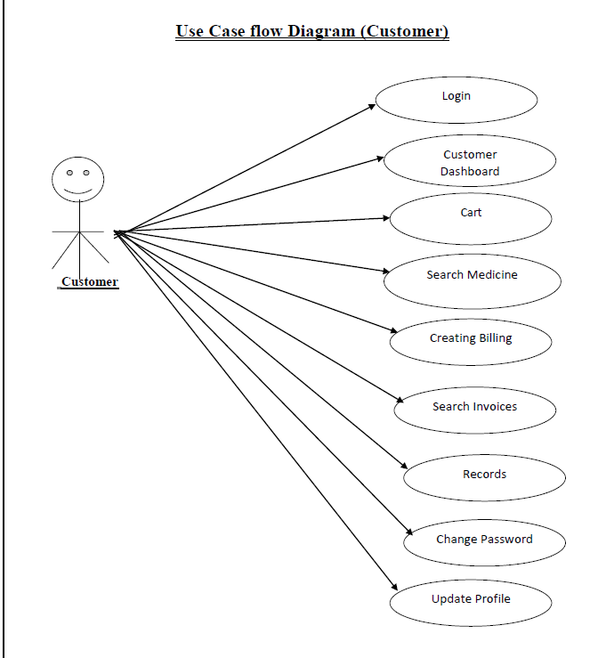
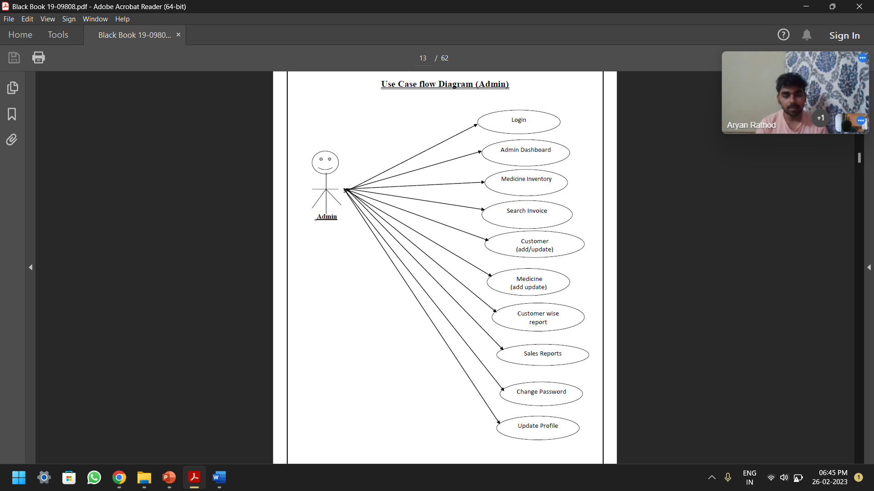
USE case flow diagram:

Slide 6
Data flow diagram:
Level: 0
Level: 1

Slide 7
Features & types of end users of this system
To provide easy accessibility of customers management
To provide easy accessibility of sales reports
To provide easy accessibility of stock reports
To provide easy accessibility of printing and prepare invoices for customers
Printing of customers and sales, Purchases and all inventory reports.
To minimise human errors
Types of End Users:
Admin (Distributer)
Admin is owner and the manager of the software, admin allowed to do any updates or modification
Customer
These are the ones who use software for their specific purpose and are restricted by the functionality provided by the software.

Slide 8
Requirement for the system:
a) Software required:
1) Vscode, 2) Google chrome, Firefox, Internet Explorer, 3)Bootstrap Framework, 4) Javascript, 5)HTML, 6)PHP, 7)My-SQL
b) Platform:
Windows
c) Tools or IDE:
Javascript, HTML, PHP, MYSQL, Bootstrap Framework
d) Database: MY-SQL

Slide 9
Screen layout and report layout:
Home Page:
Log in

Slide 10
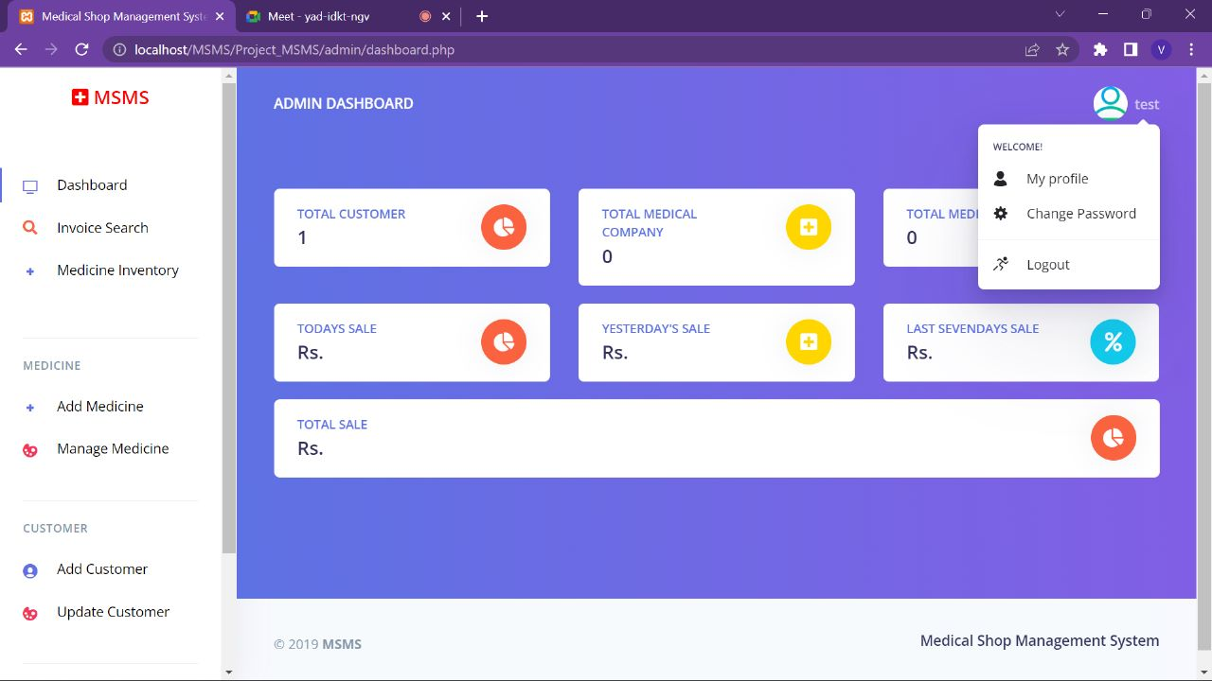
Dashboard

Slide 11
Bibliography & references
For PHP
https://www.w3schools.com/php/default.asp
https://www.sitepoint.com/php/
https://www.php.net/
For MySQL
https://www.mysql.com/
http://www.mysqltutorial.org
For XAMPP
https://www.apachefriends.org/download.html
Reference for UI
MedEZ
Provider Suite.
athenaOne

Slide 12
Thank YOU👨🏻‍⚕️

